Slide 1
S1
1.1 The basic economic problem

Slide 2
Lesson Objective
To be able to explain the nature of the economic problem
Learning Outcomes:
Define scarcity
Identify the three fundamental economic questions
Distinguish between needs and wants

Slide 3
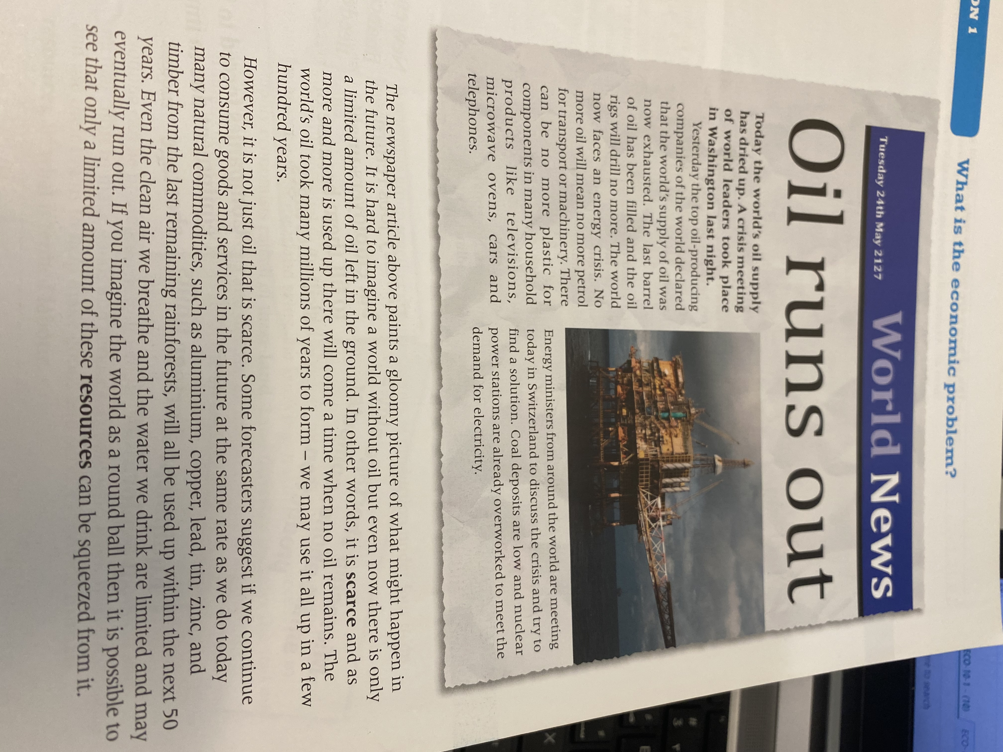

Slide 4
What do you understand by the term scarce??

Slide 5
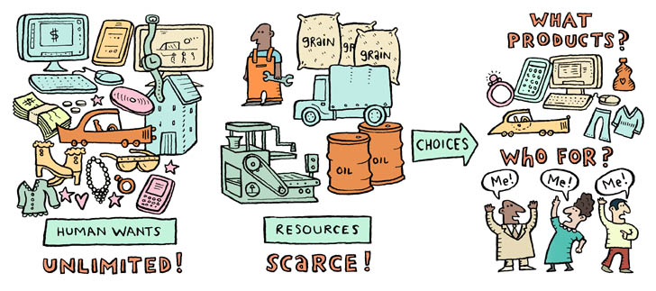
The basic economic problem
Human wants are unlimited but resources are scarce
https://youtu.be/zcN0d8foBXI

Slide 6
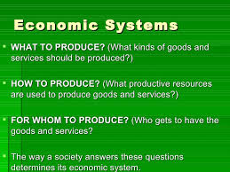

3 fundamental ECONOMIC QUESTIONS

Slide 7
What us the difference between needs and wants??
NEEDS | WANTS

Slide 8
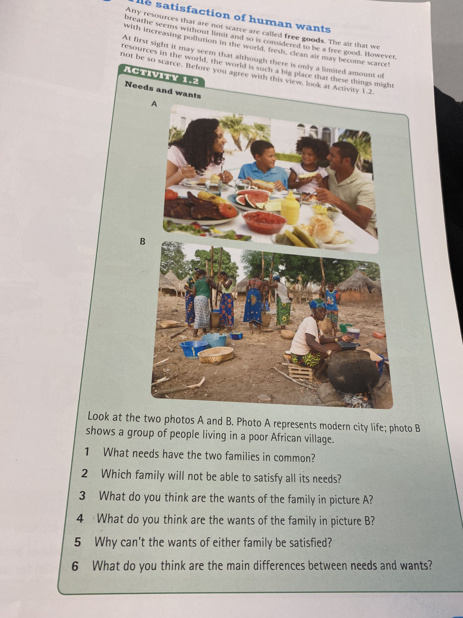
STARTER ACTIVITY

Slide 9
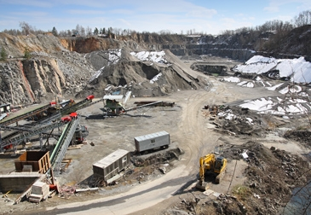
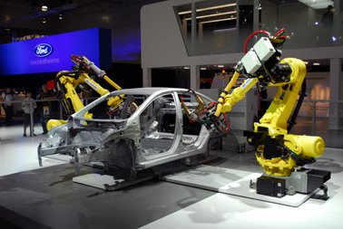

Factors of production
Natural resources = land
Man-made resources = capital
Human skills and effort = labour
Business know-how = enterprise

Slide 10
https://www.youtube.com/watch?v=VZD7dTSHmIo

Slide 11
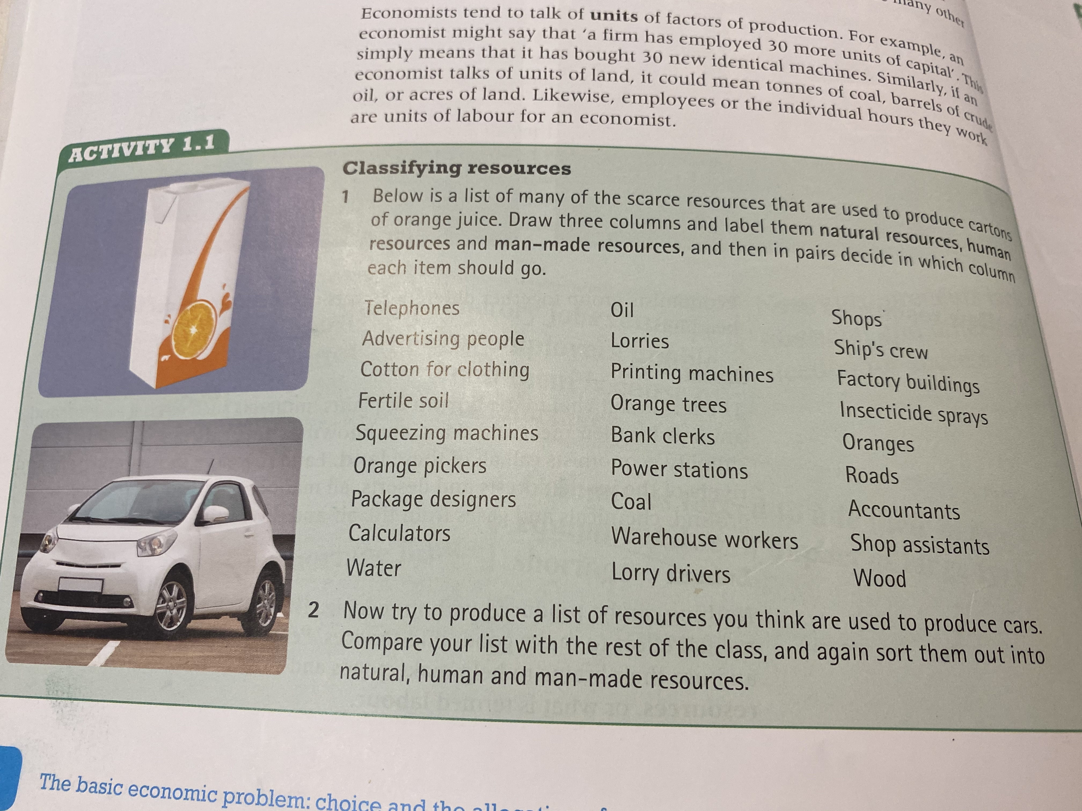
Fun Activity 1

Slide 12
Lesson Objective
To be able to explain the nature of the economic problem
Learning Outcomes:
Explain different type of goods.
Differentiate between economic goods and free goods
Explain how scarcity leads to opportunity cost

Slide 13
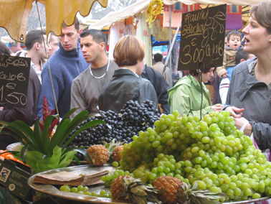
Consumption
Using up goods and services (products) to satisfy consumers’ needs and wants and consumer spending is called consumption expenditure.

Slide 14
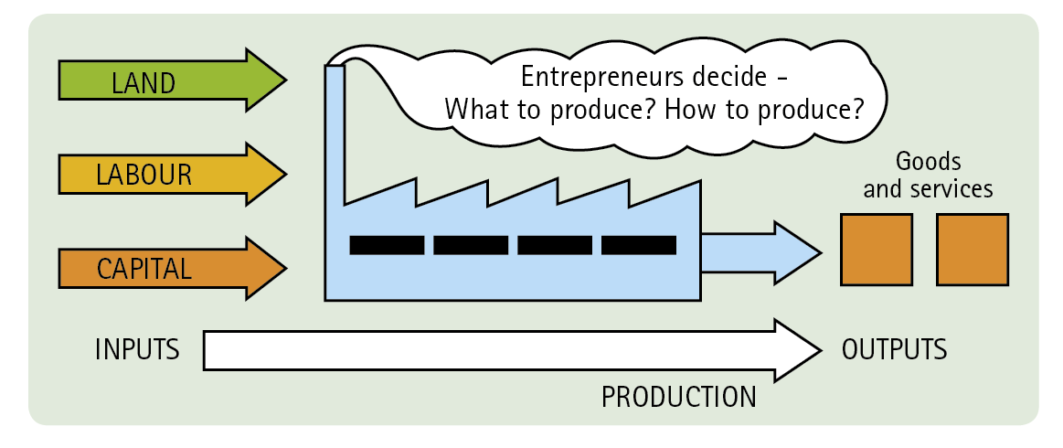
Production
Using inputs (resources) to make outputs (goods and services) to satisfy the needs and wants of consumers

Slide 15
Types of Goods
Consumer Goods: A consumer good is any good that satisfies consumer wants.
Consumer Durable Goods: These goods last a long time, example cars, washing machines, etc.
Non Durable goods are perishable or are used up quickly.
Capital Goods: Man made resources which help to produce other goods and services. Eg screw drivers, factory buildings etc.
Public Goods: a public good is a good that is both non-excludable and non-rivalrous, in that individuals cannot be excluded from use or could benefit from without paying for it, and where use by one individual does not reduce availability to others
Merit Goods: Goods or services whose consumption is believed to confer benefits on society as a whole greater than those reflected in consumers' own preferences for them. Eg: healthcare, education etc.

Slide 16
Economic Goods Vs Free Goods
Economic goods :
An economic good will have some degree of scarcity in relation to demand. It is the scarcity that creates a value people become willing to pay for. Eg: Car, Book etc
Free Goods:
A free good is a good that is not scarce, and therefore is available without limit and thus people do not pay for them. Eg Sunlight ,Air etc

Slide 17






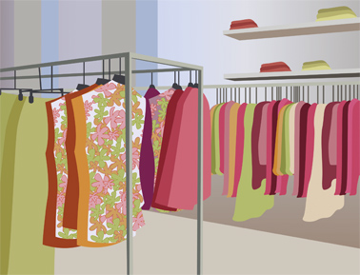
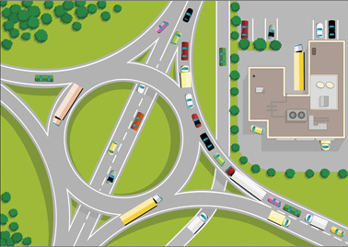
Choice
Identify the different types of goods from the pictures given below.
People and governments only have a limited amount of money but have many needs and wants to satisfy
$100bn
$100
Food? Entertainment?
Clothing?
Defence? Health care?
Roads?

Slide 18
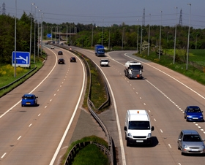
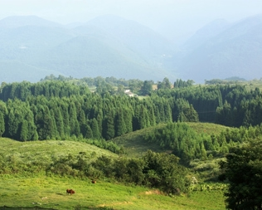
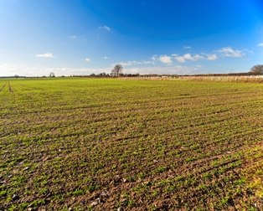
So, we all have to make choices
There is a limited amount of resources such as raw materials, machines, factories and skilled workers. But there are a number of different ways in which they can be used.
CHOICE
CHOICE
Resource allocation therefore involves deciding how best to use scarce resources to satisfy as many needs and wants as possible

Slide 19
Opportunity Cost
In microeconomic theory, the opportunity cost, or alternative cost, of making a particular choice is the value of the most valuable choice out of those that were not taken.
Opportunity cost is the benefits/value of the next best alternative forgone.
https://youtu.be/NwOYLV-L7pc

Slide 20
Opportunity cost
Opportunity cost is the cost of choice
What would you buy with US$10?
How should the government spend US$250 million?
(Or, should the government cut taxes by US$250 million?)
What occupation will you choose when you finish your studies?
How should a new business invest US$20 million?
Should we conserve more natural resources?
… and what are the next best alternatives foregone?

Slide 21
Production possibility curves
Production possibility curves (PPCs) show the maximum combined output of two or more products a firm or an entire economy can produce with its available resources & technology
Resources are being used efficiently if they are producing their maximum output
But, because resources are limited, producing more of one product means producing less of another
PPCs are therefore a useful way of showing the opportunity cost of producing more of one product in terms of how much of another must be given up

Slide 22
https://youtu.be/O6XL__2CDPU

Slide 23
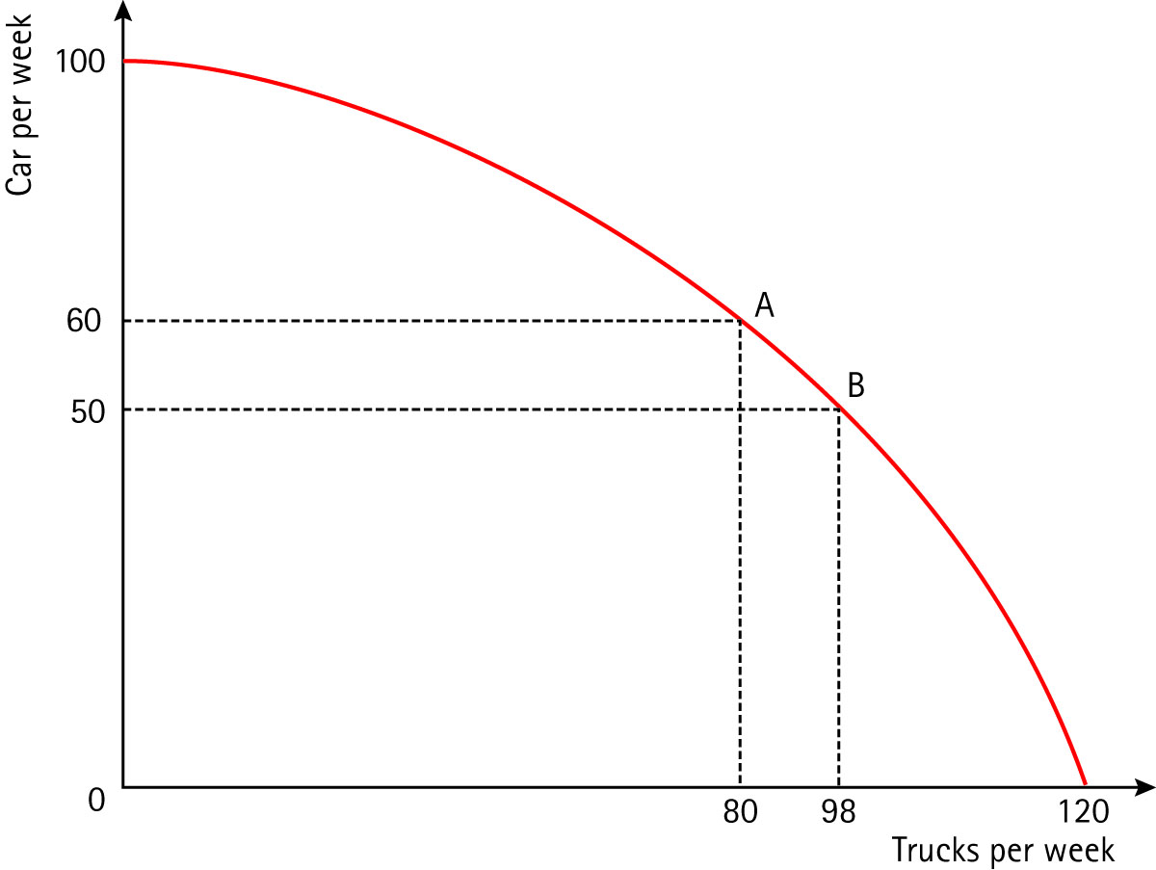
Production possibility curves
A firm producing cars and trucks
What is the opportunity cost of producing 18 more trucks ?
What is the opportunity cost of producing 10 more cars?

Slide 24
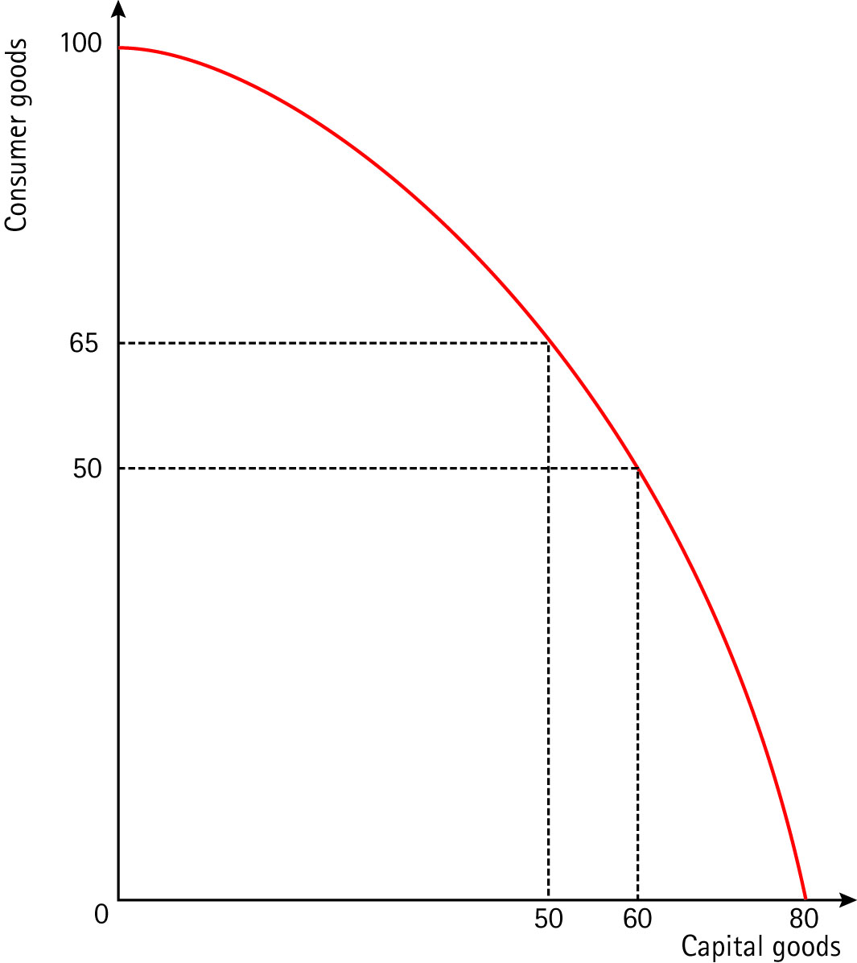
Production possibility curves
An economy producing consumer goods and capital goods
What is the opportunity cost of producing 15 more tonnes of consumer goods?

Slide 25
Learning Objective: To be able to understand the concept of conflicts of interest due to opportunity cost
Learning Outcomes:
Identify the reasons behind shifts in PPC
Explain conflicts of interests as a result of scarcity of resources
This lesson is a more activity based lesson and requires students to be constantly engaged in different learning activities which will enhance their previous lesson’s knowledge of opportunity cost and conflicts of interest

Slide 26
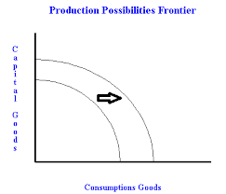
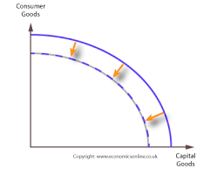

Slide 27
https://youtu.be/31T3do2h2DM
https://youtu.be/1FHksyApxmE
Based on the information from the above resources, explain the concept of conflicts of interest.

Slide 28
Activity 1.6 – Page 12
Activity 1.7 – Page 14
Activity 1.8 – Page 16

